Slide 1
Chapter 7

Slide 2
Video: Ostrowski D. [2022] Upload capability in React
- covering the initialization of S3 resources on Amazon AWS
Video: Ostrowski D. [2002] Upload integration with large Scale React applications
- installation and testing of the uploading of resources with React.js

Slide 3
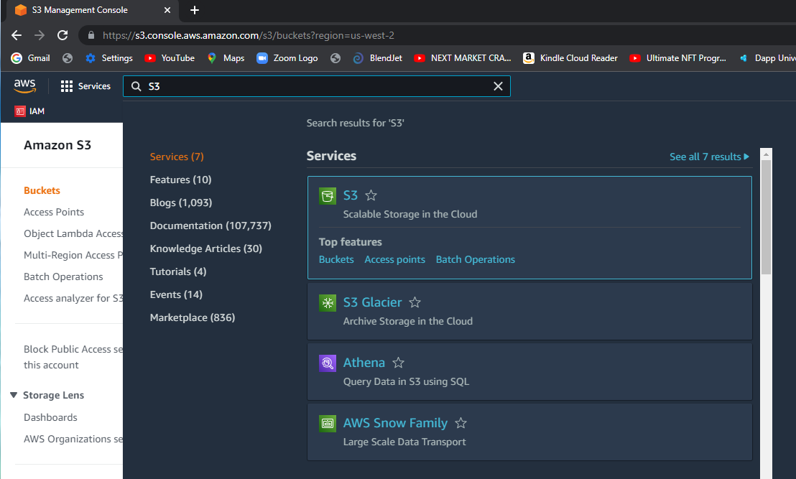
S3 – how to find it?

Slide 4
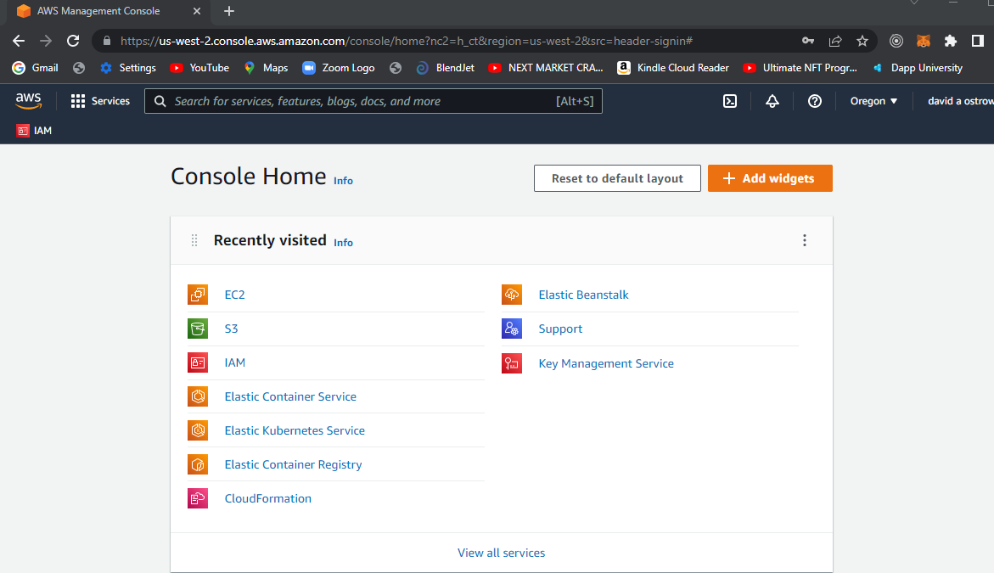
S3

Slide 5
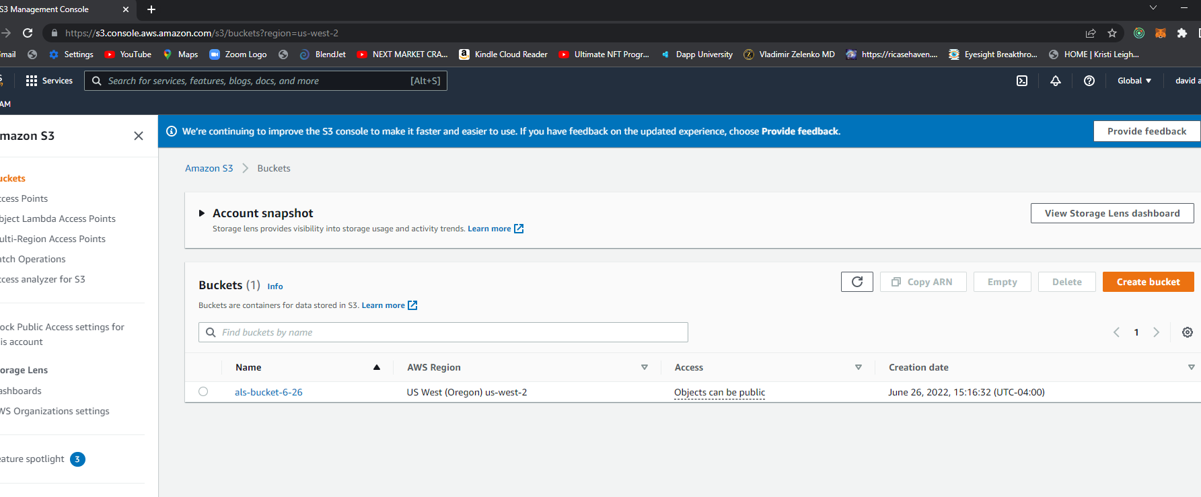

Slide 6
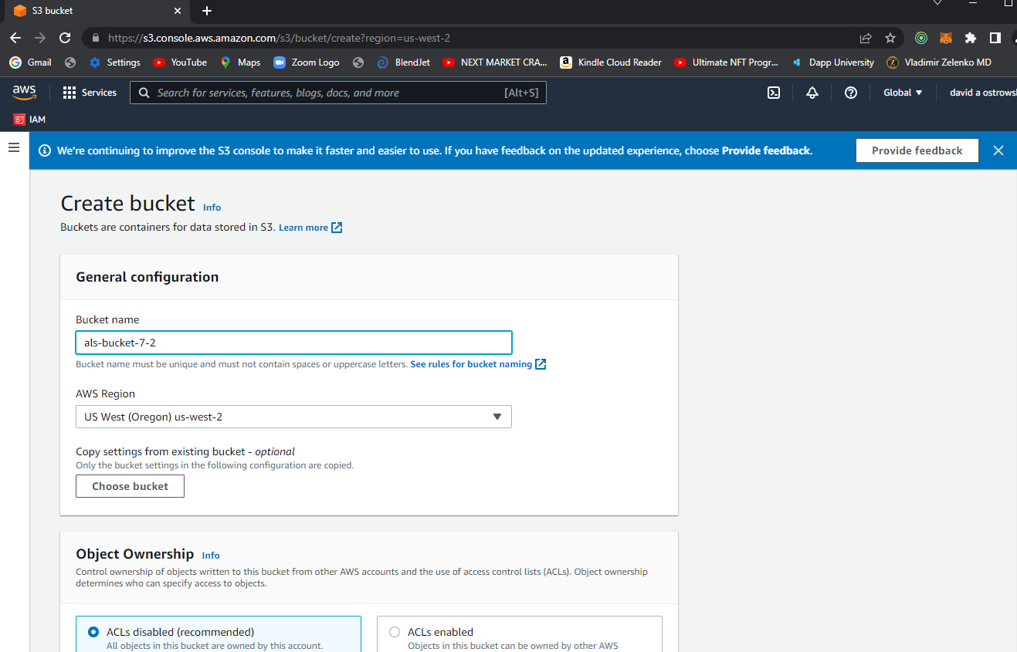

Slide 7
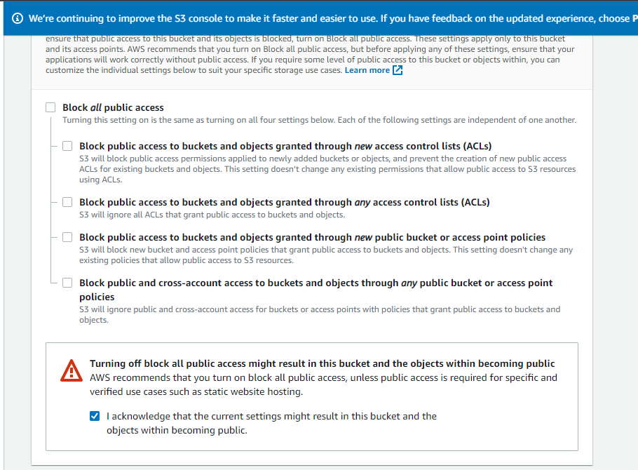

Slide 8
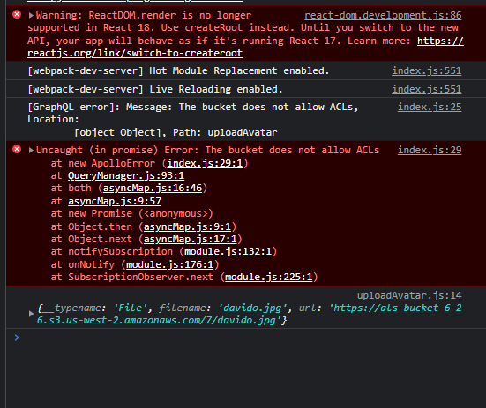

Slide 9
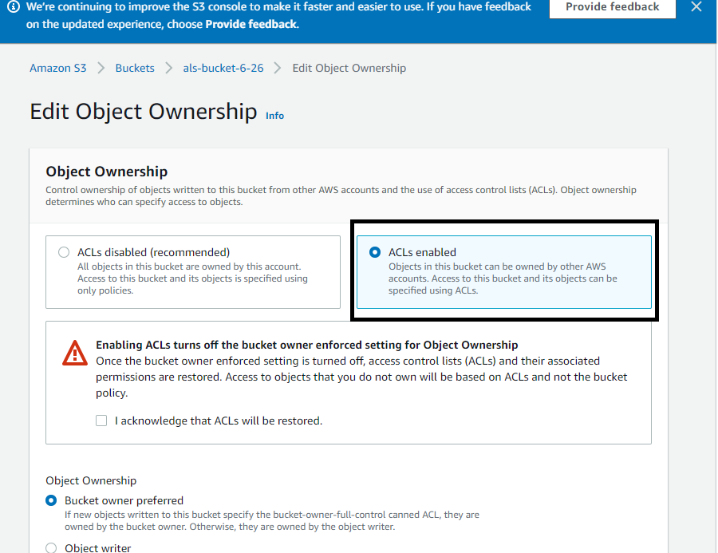

Slide 11
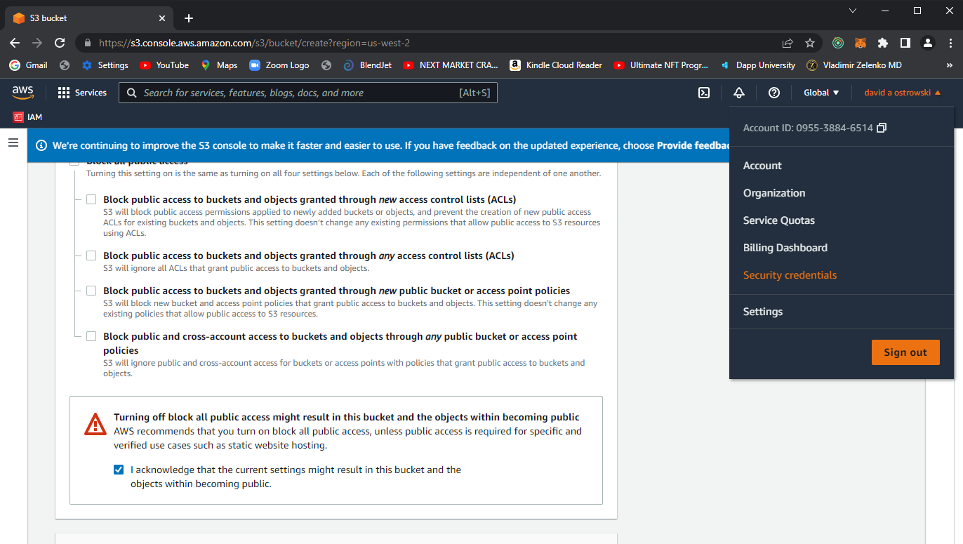
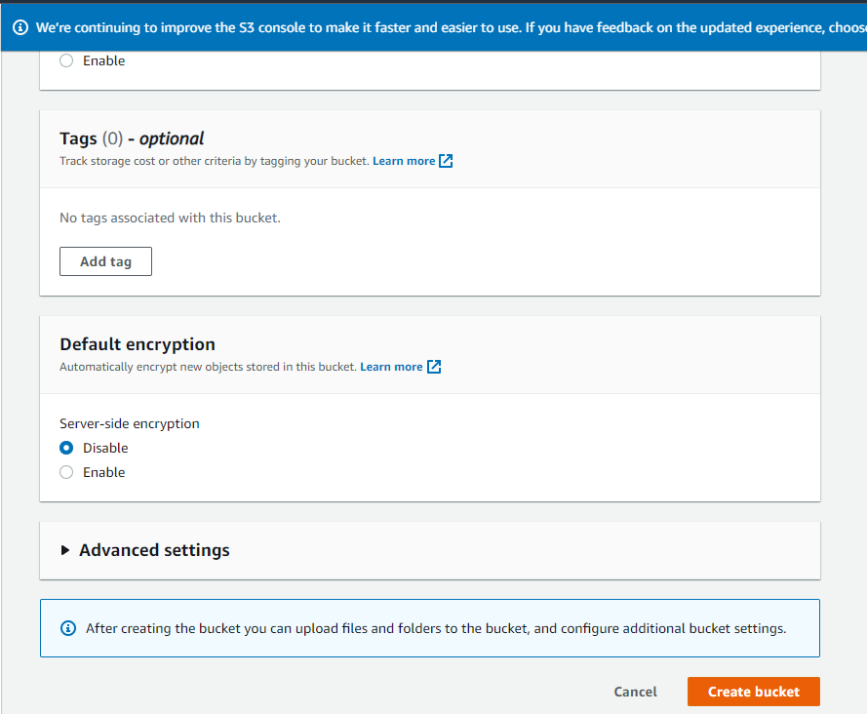

Slide 12
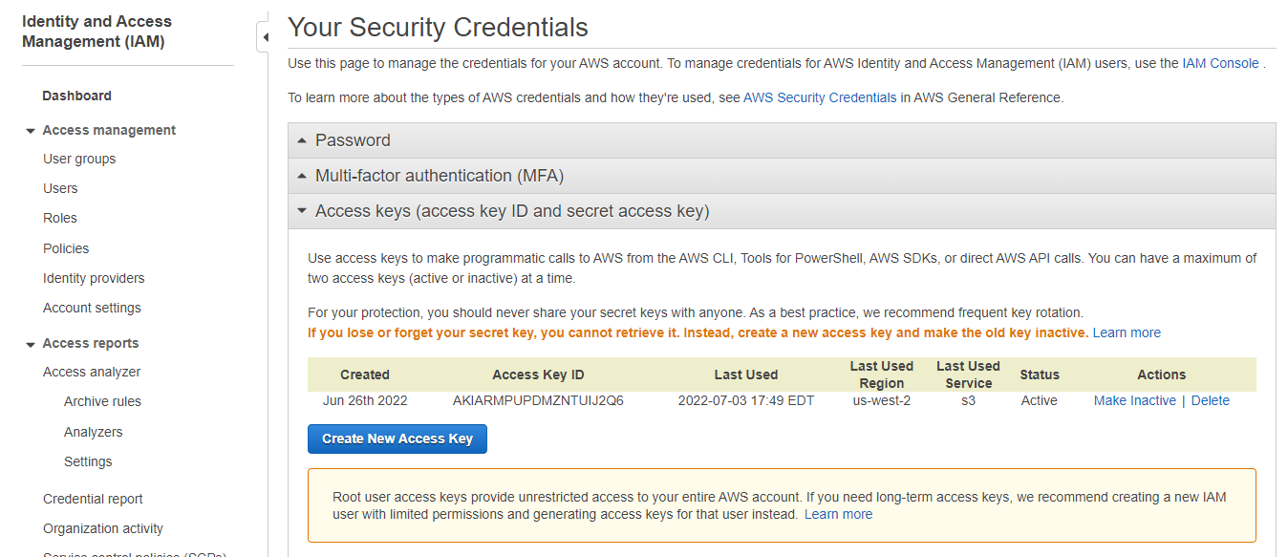

Slide 13
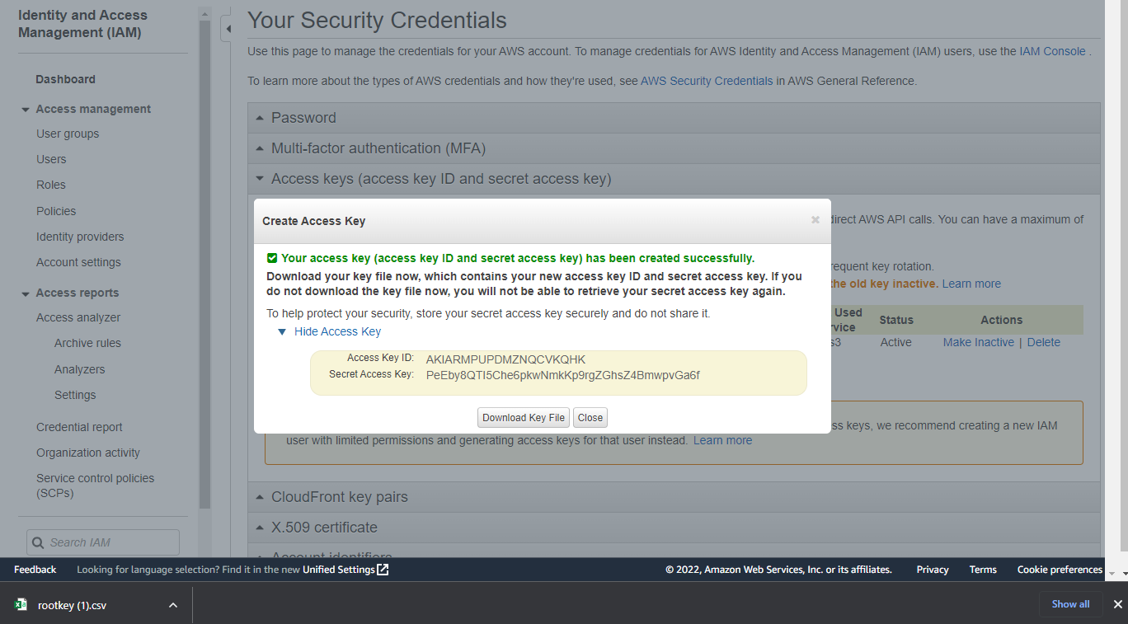

Slide 14
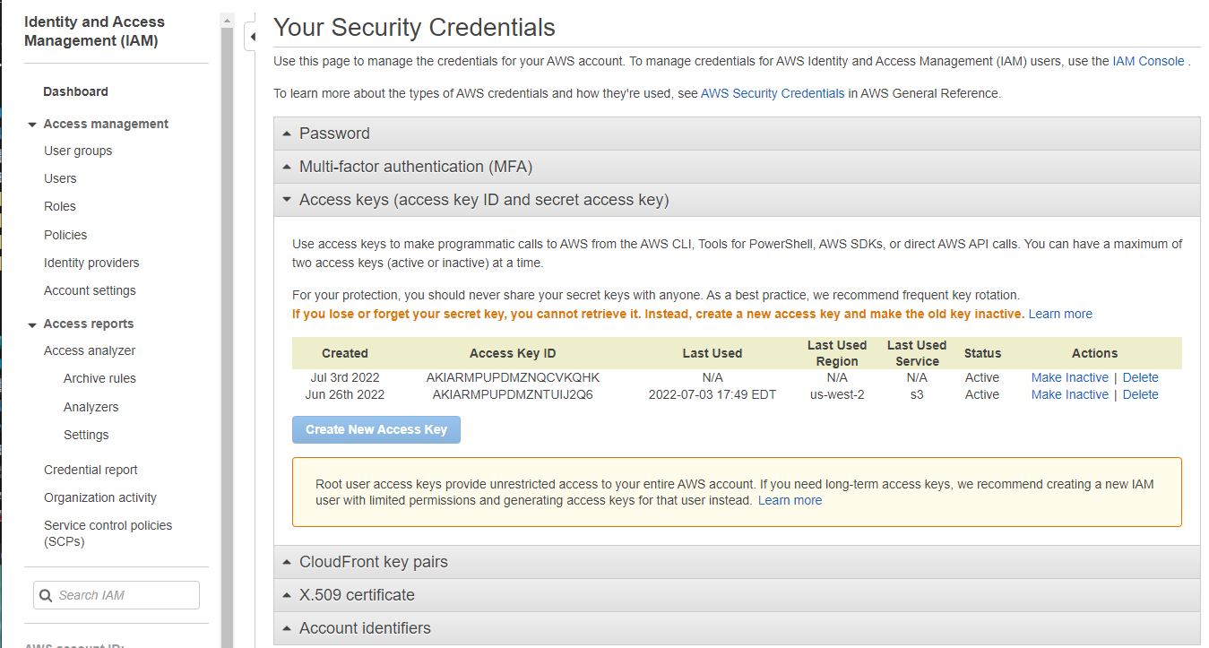

Slide 15
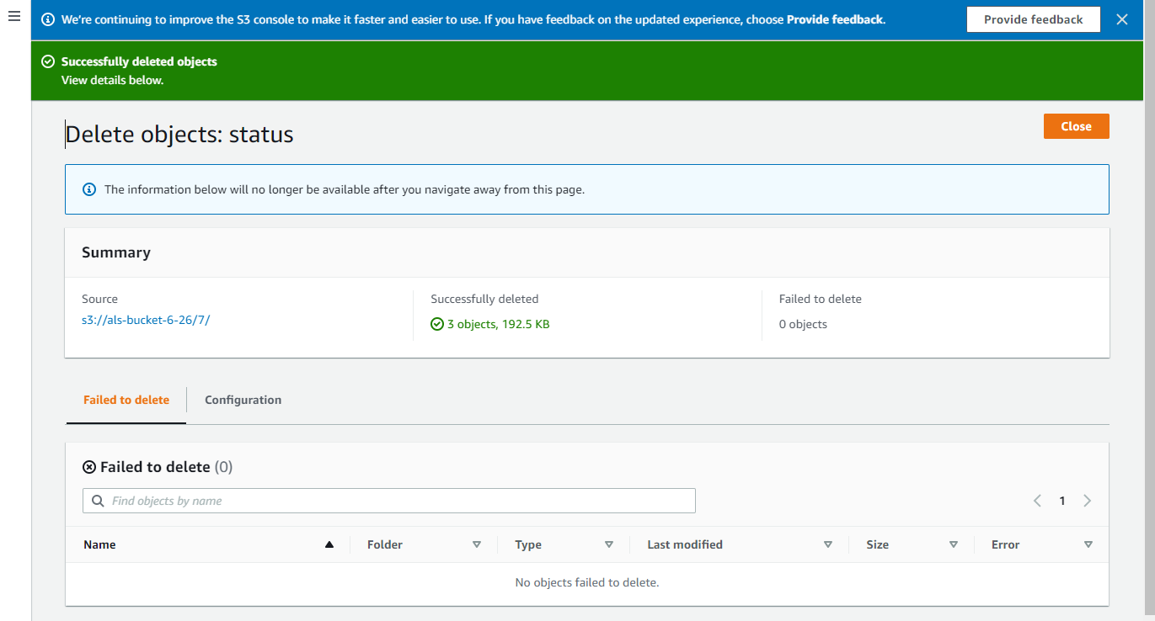

Slide 16
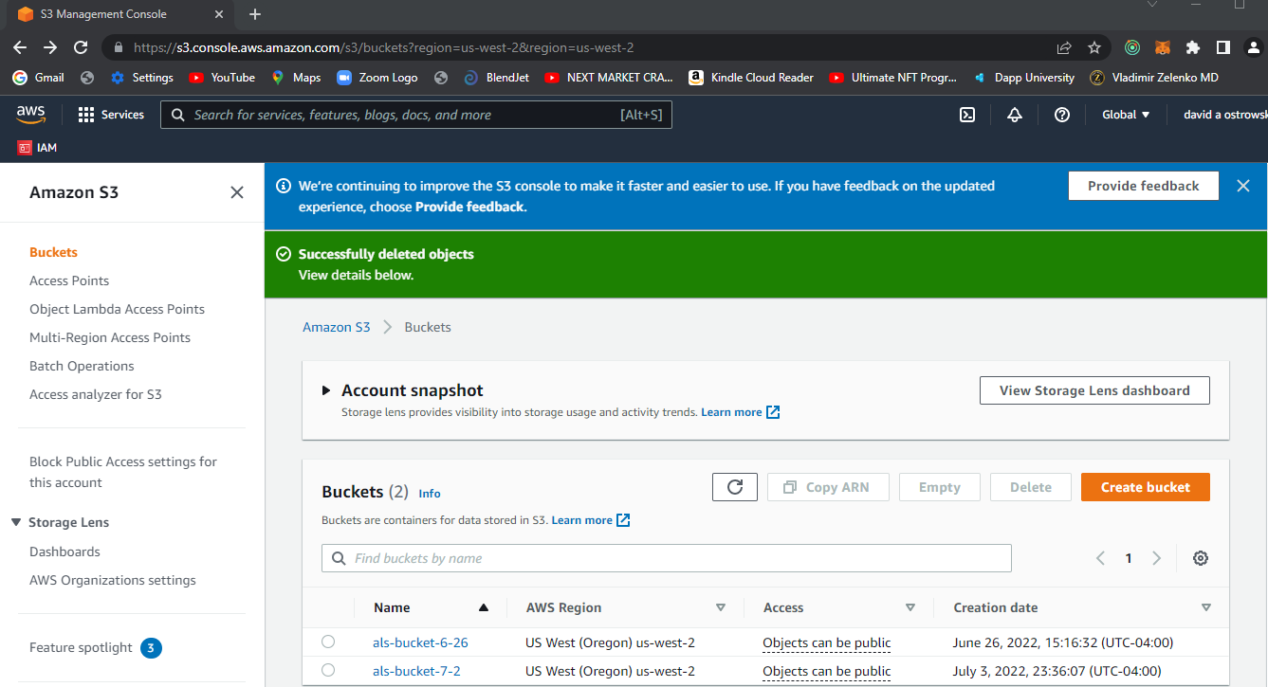

Slide 17
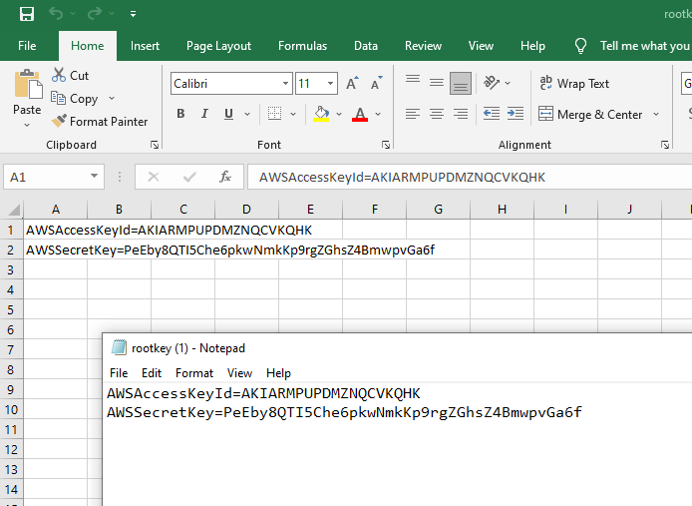

Slide 18
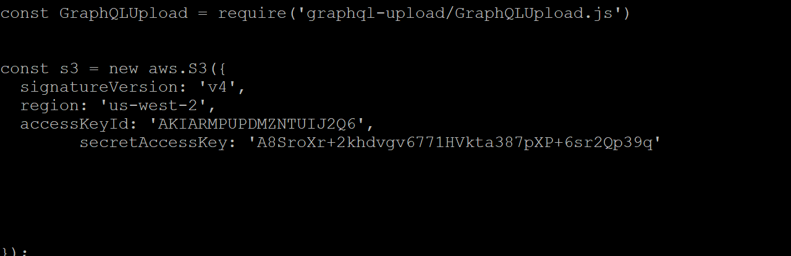

Slide 19
Run instructions
Change webpack.client.config
Change src/client/apollo/index.js

Slide 20
Prerequisite software
All functionality from chapter 1 -6
Make sure you include the changes to support the ‘user’ context among the modules
(this includes all software described in “CurrentUser GraphQL Query” presented on pp 238 – 239.)
(this also includes all software described under the section of “authenticating GraphQL requests”)

Slide 21
Included functionality from chapter six that is necessary for the support of chapter seven
Authenticating GraphQL requests
Graphbook/src/client/apollo/index.js
Graphbook/src/client/apollo/index.js
Graphbook/src/server/services/graphql/auth.js
Graphbook/src/server/services/graphql/index.js
/src/server/services/graphql/schema.js
/src/server/services/graphql/resolvers.js
/src/client/apollo/queries/ CurrentUserQuery.js
/src/client/App.js
/src/client/components/context/user.js

Slide 22
Files modified
All files from the prior five chapters

Slide 23
Files modified
graphbook/src/server/index.js
graphbook/src/server/services/graphql/schema.js
graphbook/src/client/apollo/mutations/uploadAvatar.js
graphbook/src/server/services/graphql/resolvers.js
graphbook/src/client/apollo/index.js
graphbook/src/client/apollo/mutations/uploadAvatar.js
graphbook/src/client/apollo/fragments/userAttributes.js
graphbook/src/client/components/avatarModel.js
graphbook/src/client/components/bar/user.js

Slide 24
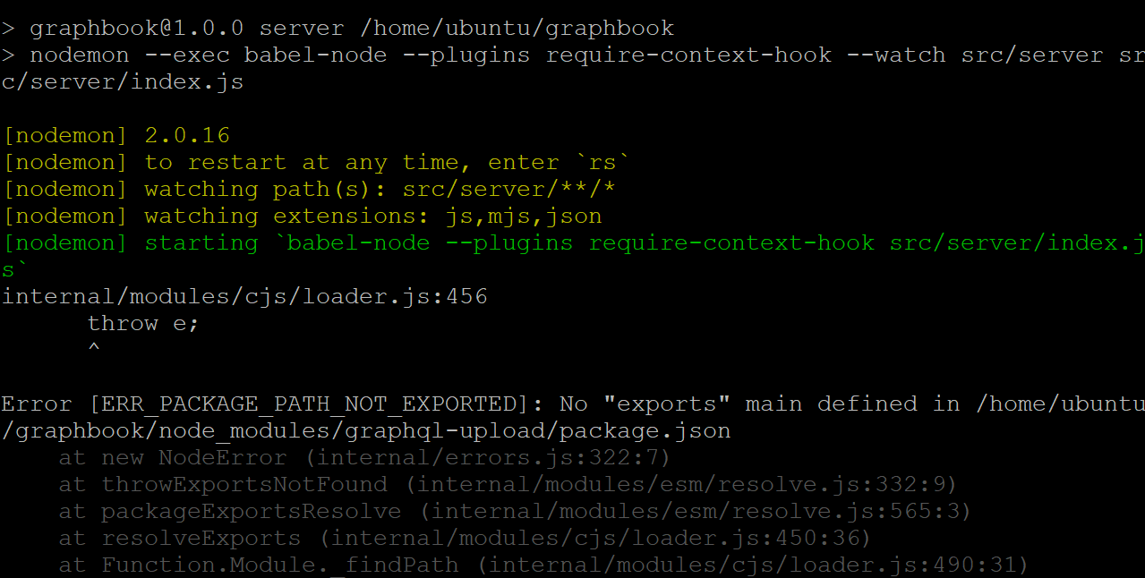

Slide 25
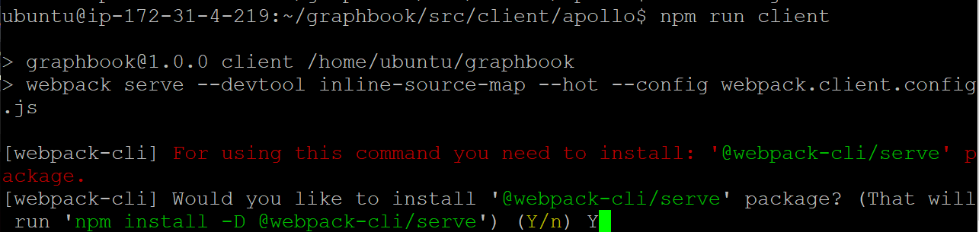

Slide 26
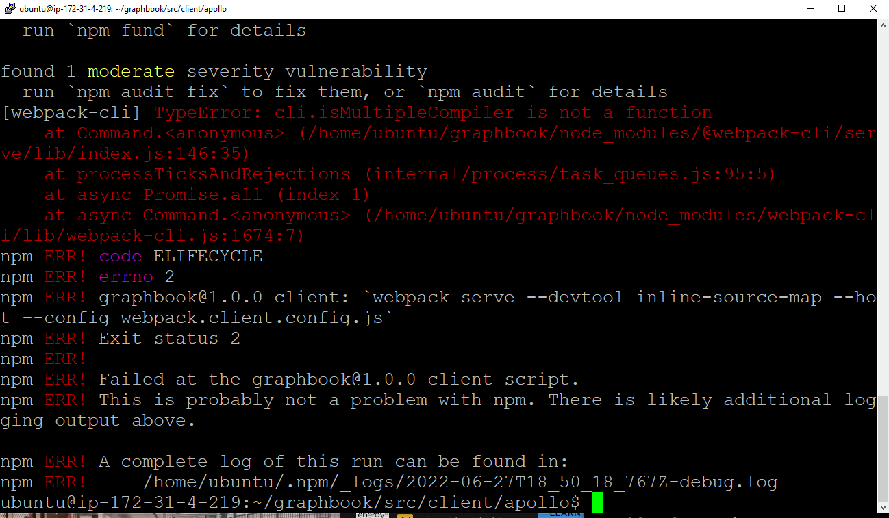

Slide 28
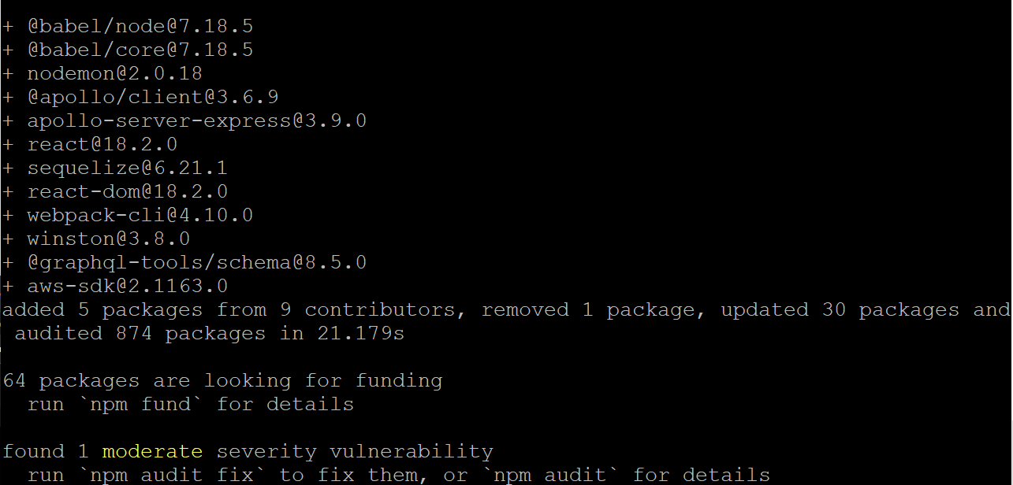

Slide 29
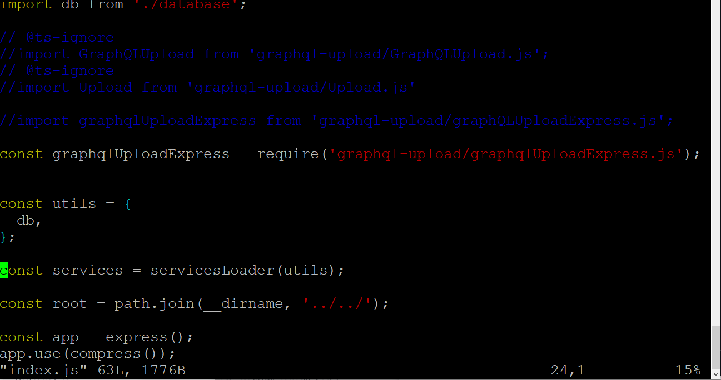
The fix: three files
ubuntu@ip-172-31-4-219:~/graphbook/src/server$ vi index.js

Slide 30
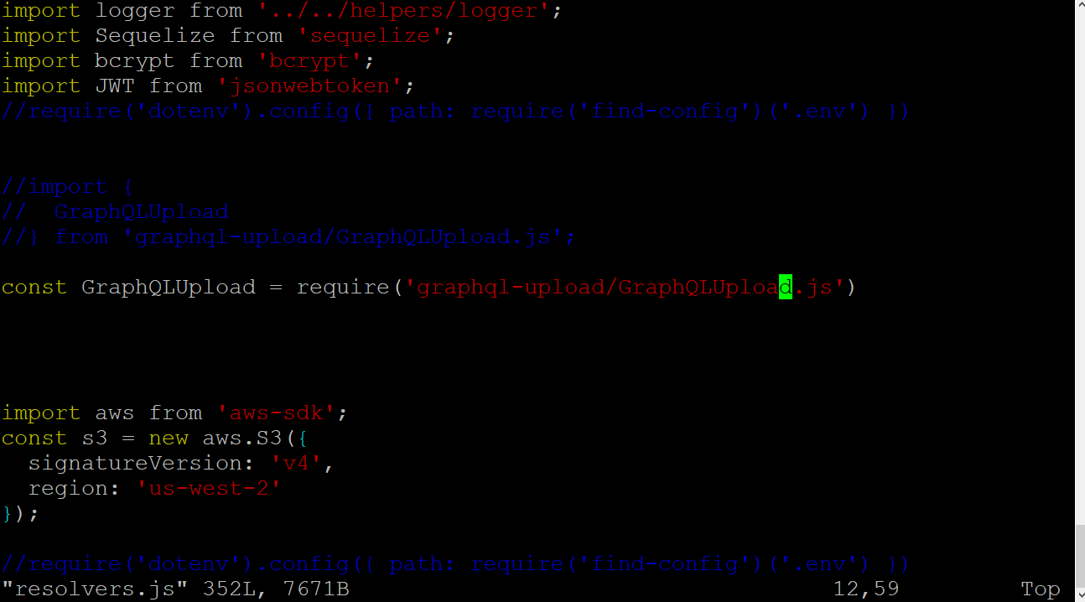
Src/server/services/graphql/resolvers.js is the file to change (only one single line for the GraphQLUpload

Slide 31
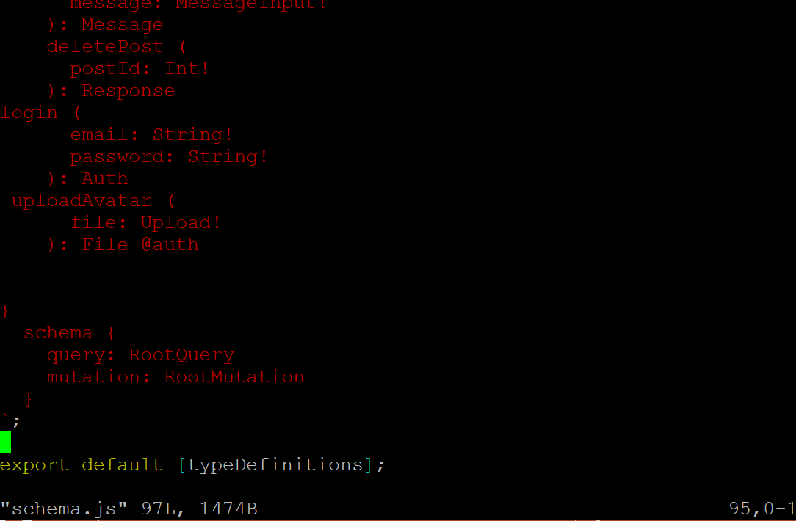
Src/server/services/graphql/schema.js

Slide 32
npm update && npm audit fix --force

Slide 33
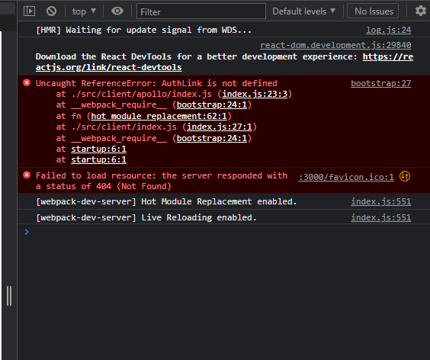

Slide 34
Fix ( I added the following code) to src/client/apollo/index.js
const AuthLink = (operation, next) => {
const token = localStorage.getItem('jwt');
if(token) {
operation.setContext(context => ({
...context,
headers: {
...context.headers,
Authorization: `Bearer ${token}`,
},
}));
}
return next(operation);
};

Slide 35
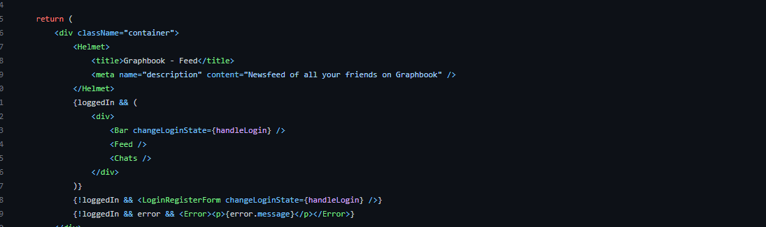

Slide 36
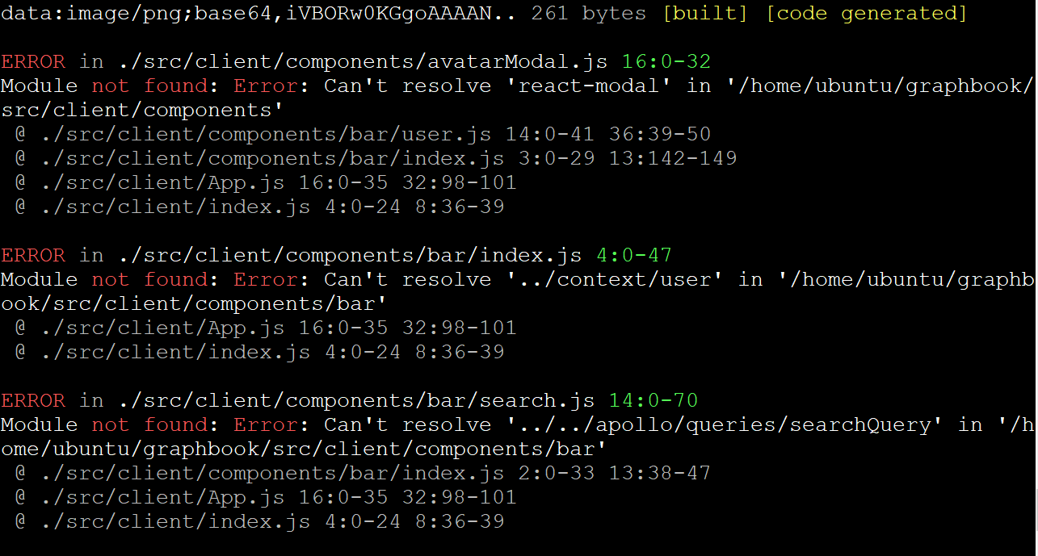

Slide 37
Install react-modal
ubuntu@ip-172-31-4-219:~/graphbook/src/client/components/context$ npm install --save react-modal react-dropzone react-cropper

Slide 38
Add user.js under graphbook/src/client/components/context/user.js

Slide 39
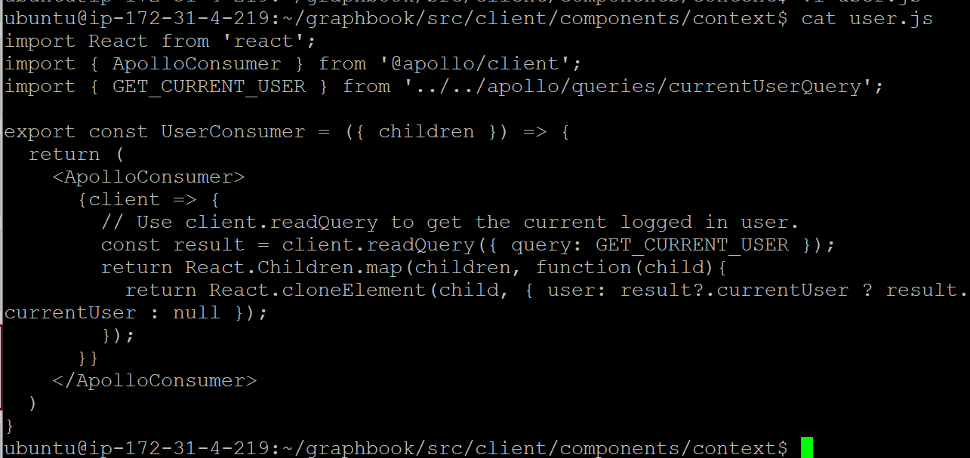

Slide 40
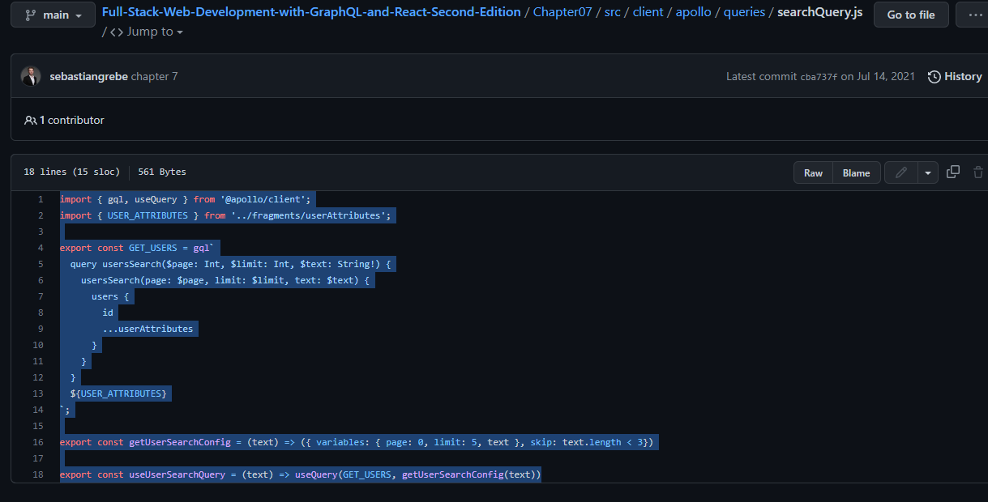

Slide 41
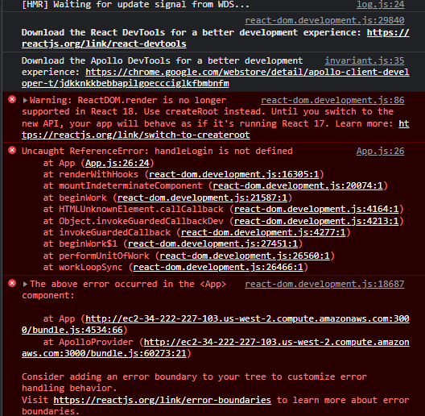

Slide 42
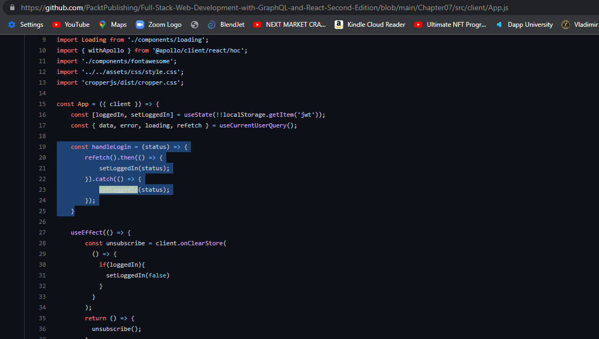

Slide 43
ubuntu@ip-172-31-4-219:~/graphbook/src/client/components/context$ vi user.js
ubuntu@ip-172-31-4-219:~/graphbook/src/client/components/context$

Slide 44
ubuntu@ip-172-31-4-219:~/graphbook/src/client/components/bar$ vi user.js
import React, { useState } from 'react';
import AvatarModal from '../avatarModal';
const UserBar = ({ user }) => {
const [isOpen, setIsOpen] = useState(false);
const showModal = () => {
setIsOpen(!isOpen);
}
if(!user) return null;
return (
<div className="user">
<div>did i make it here</div>
<img src={user.avatar} onClick={() => showModal()} />
<AvatarModal isOpen={isOpen} showModal={showModal}/>
<span>{user.username}</span>
</div>
);
}

Slide 45
ubuntu@ip-172-31-4-219:~/graphbook/src/client/apollo$ vi index.js

Slide 46
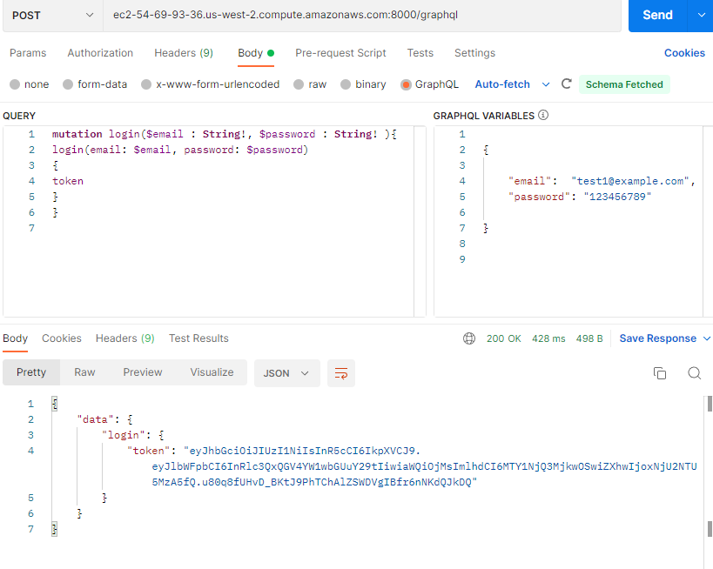

Slide 47
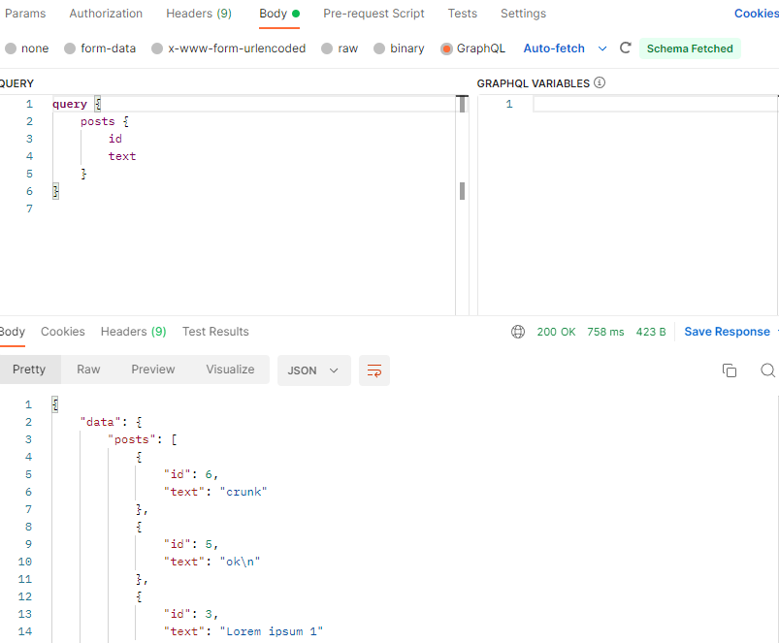

Slide 48
Current problem – my graphql endpoint is not storing the ‘current User ‘ information.

Slide 49
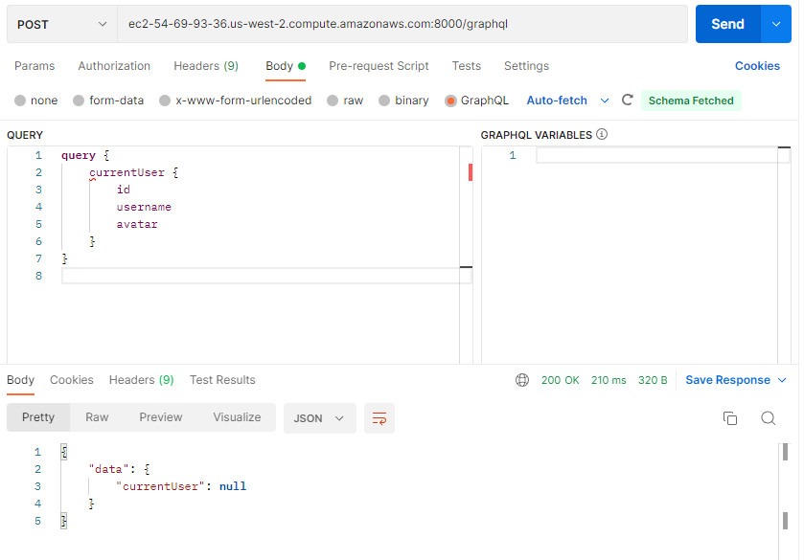

Slide 50
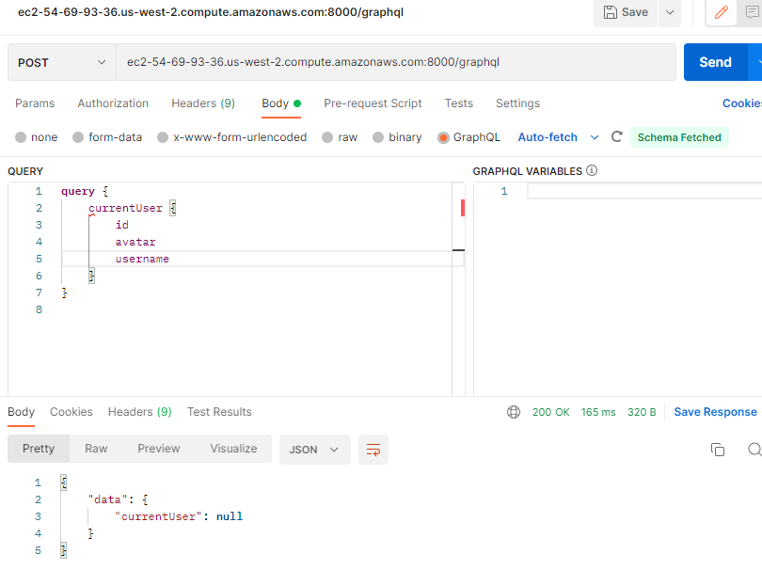

Slide 51
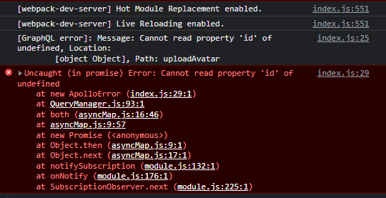

Slide 52
Solution: add code from pp225 – pp 240 in particular auth.js file

Slide 53
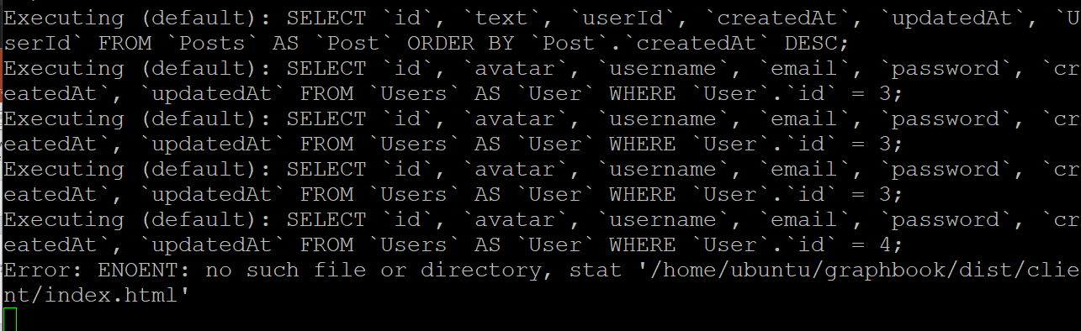
?

Slide 54
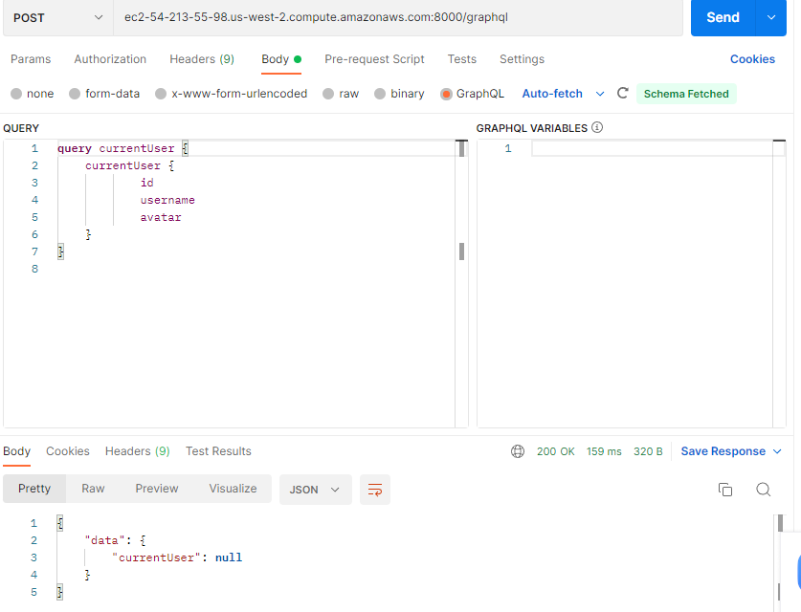

Slide 56
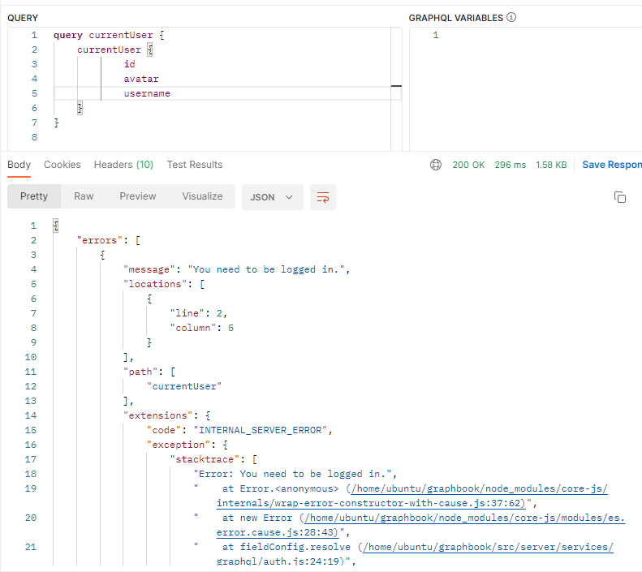
https://stackoverflow.com/questions/67757608/aws-sdk-missing-credentials-in-config
Solution is the hardcode the variable….

Slide 57
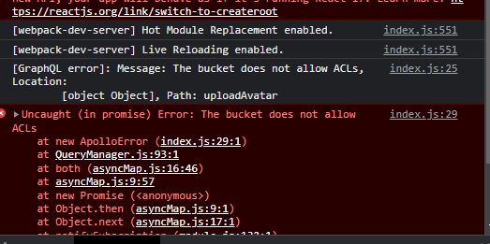
problem

Slide 60
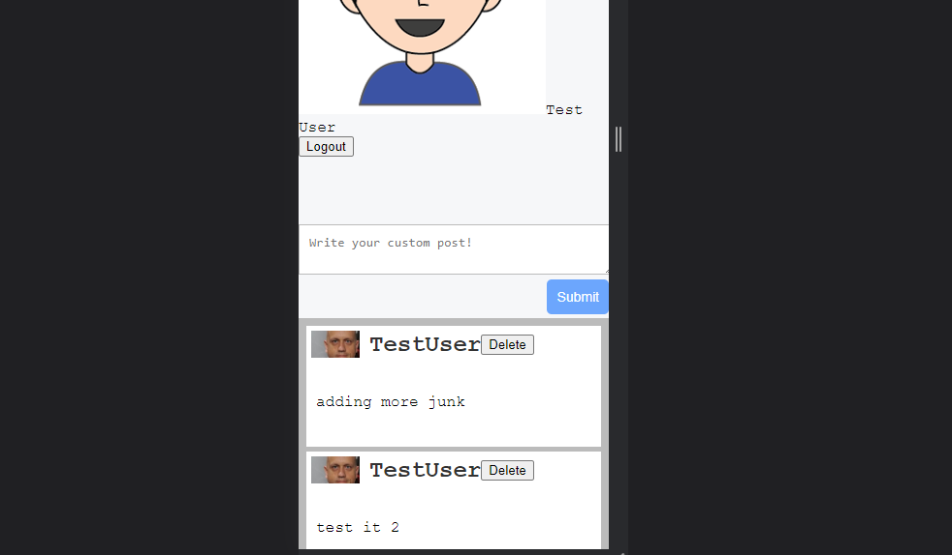
Boom.

Slide 63
